Slide 1
TECHNICAL FORUM
PHASE 1:REQUIREMENTS GATHERING

Slide 2
Introduction
What is forum website?
An Internet forum, or message board, is an online discussion site where people can hold conversations in the form of posted messages. They differ from chat rooms in that messages are often longer than one line of text, and are at least temporarily archived.
The definition of a forum is a place or a method for discussion. An example of a forum is Quora, Stackoverflow.

Slide 3
Who uses our site?
Our site can help the new comers about getting information about programming languages. It will also be useful for getting information about various technical questions. Users can satisfy their needs of getting information related to various programming languages from a single source. To make a form that give information about various technical questions .
The questions are based on various programming languages.
The various questions are like how to setup the languages, datatypes etc.

Slide 4
SYSTEM REQUIREMENTS
SOFTWARE REQUIRES:-
Platform - Windows 8,10
Front end – CSS3,Javascript
Backend – php,mysql
Server – Wamp
Framework – Drupal

Slide 5

Technical forum (name)
Home
About
Forum
Blog
Notification

Slide 6
Login page
 | LOGIN
USERNAME
PASSWORD
SUBMIT | CANCEL | SIGN UP

Slide 7
Register page
 | Register
Username
Last name
password
Email
Phone no
Submit | Cancel

Slide 8
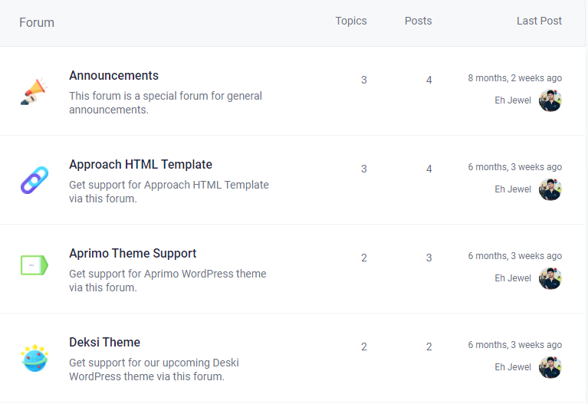
home page overview of forums

Slide 9

about
Contents….
Adopt a customer first mindset
Be flexible and inclusive
Learn, share, grow
Be transparent
Keep community at our center
Empower people

Slide 10
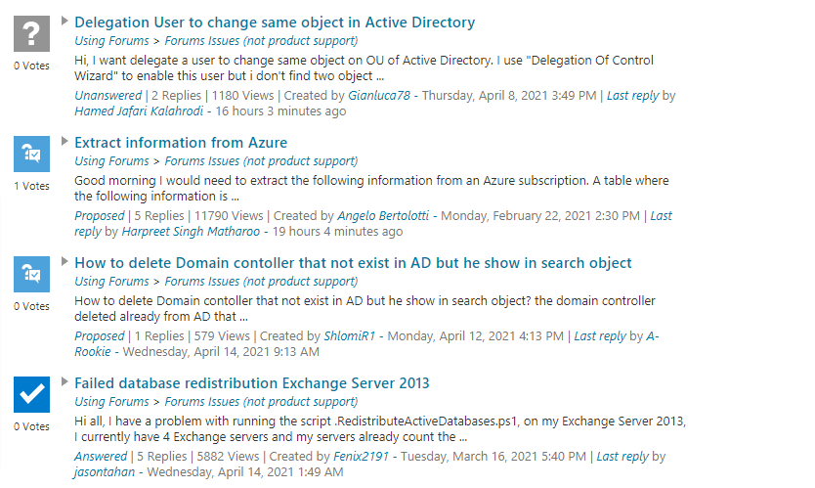

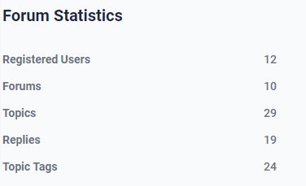
forum

Slide 11
blogs
CONTENT
Recent comments

Slide 12
notifications
New notifications
Filters
All notification
Questions
Comments and mentions
Your content
Your profile

Slide 13
FOOTER
EMAIL | SUBSCRIBE
OUR SERVICE | CAREERS | OVERVIEW
Links of Facebook, linkedin, instagram, youtube

Slide 14
END

